Slide 1
Department of Ophthalmology
University College of Medical Sciences
&
Guru Teg Bahadur Hospital
New Delhi

Slide 2
Outline
Services provided by Department
Faculty and Staff
• Teaching faculty
Professors: 3; Assistant Professors: 4
• Residents: SRs 5; and JRs 15
• Non-teaching staff : stenographer 1, refractionist 3, OT technicians
Infrastructure
Equipment
Publications by faculty

Slide 3
Services provided by the department
Comprehensive ophthalmic care all type of major and minor eye diseases.
Management both medical and surgical of emergency cases.
Major type of ocular surgeries performed by the department include: phacoemulsification, SICS, ECCE, Paediatric cataract surgery, various type of glaucoma surgeries including Trabeculectomy with / without mitomycin C, Trabeculectomy with amniotic membrane, glaucoma implants, destructive procedures, surgery for congenital glaucoma. All types of ptosis, lid reconstruction, orbitotomy. All types of lacrimal sac & canalicular surgeries, trauma surgeries, simple retinal /VR surgeries, anterior and pars plana vitrectomies, surgeries for squint, enucleation evisceration, ectropion, entropion, pterygium, limbal grafts, amniotic membrane transplant.
Department also provides Eye Bank and Cornea grafting services.

Slide 4
Services provided by the department
Visual handicap certificates to the residents of East Delhi.
Medical Examinations/Fitness for various jobs including Civil Services.
Department is providing free glasses to children less than 18 years and senior citizens.
Apart from conducting undergraduate and postgraduate examinations of the college, the department is also a Centre for conducting the International council of Ophthalmology examinations and DNB ophthalmology examinations regularly.

Slide 5
Staff -Teaching Faculty
S. No. | Name | Designation | Qualification | Requirement Fulfilled
1 | Dr. Jolly Rohatgi | Professor and HOD | MBBS, MS | YES
2 | Dr. G.K. Das | Director Professor | MBBS, MD, DNB
3 | Dr. P.K. Sahu | Director Professor | MBBS, MD
4 | Dr. Siddharth Madan | Assistant Professor | MBBS, MS, DNB
5 | Dr. Pranita Sahay | Assistant Professor | MBBS, MD, DNB
6 | Dr. Ankur Singh | Assistant Professor | MBBS, MS
7 | Dr. Rekha Yadav | Assistant Professor | MBBS, DO, DNB (Secondary)

Slide 6
List of PG teachers as per NMC norms
Serial no. | Name | Designation | Post MS experience
1 | Dr. Jolly Rohatgi | Professor and HOD | 32 years
2 | Dr. G.K. Das | Director Professor | 24 years
3 | Dr. P.K. Sahu | Director Professor | 19 years

Slide 7
Staff – Senior Residents
S. No. | Name | Designation | Qualification | Requirement fulfilled
1 | Dr. Swati Verma | Senior resident | MBBS, MS | Yes
2 | Dr. Puja Rai | Senior resident | MBBS, MS
3 | Dr. Nitika Beri | Senior resident | MBBS, MS
4 | Dr. Priyanka Gautam | Senior resident | MBBS, MS
5 | Dr. Ishita Bajaj | Senior resident | MBBS, MS

Slide 8
Staff – Junior Residents
S. No. | Name | Designation | Qualification | Requirement fulfilled
1 | Dr. Isha Sharma | Post-graduate (3rd year) | MBBS | Yes
2 | Dr. R. Janani | Post-graduate (3rd year) | MBBS
3 | Dr. Isha Acharya | Post-graduate (3rd year) | MBBS
4 | Dr. Anchal Arora | Post-graduate (3rd year) | MBBS
5 | Dr. Ashit Handa | Post-graduate (3rd year) | MBBS
6 | Dr. Aarushi Saini | Post-graduate (2nd year) | MBBS
7 | Dr. Iffat Nasir | Post-graduate (2nd year) | MBBS
8 | Dr. Pratibha Sesama | Post-graduate (2nd year) | MBBS
9 | Dr. Akshita Agarwal | Post-graduate (2nd year) | MBBS
10 | Dr. Nampi Tadu | Post-graduate (2nd year) | MBBS
11 | Dr. Anam Ansari | Post-graduate (1st year) | MBBS
12 | Dr. Tanya Bisht | Post-graduate (1st year) | MBBS
13 | Dr. Priyanka Gupta | Post-graduate (1st year) | MBBS
14 | Jubin Singh | Post-graduate (1st year) | MBBS
15 | Dr. Priya Verma | Post-graduate (1st year) | MBBS

Slide 9
Staff – Ancillary
S . No. | Designation | Name | Requirement Fulfilled
1 | Technical Assistant/Technician | Mr Umesh Chandra Mr Bir Singh Miss Usha | Yes
2 | Stenographer | Mr Rajesh Oraon | Yes
3 | Refractionist | Mr. Kanwal Kishore Gaba Mr Ravinder Kumar Tyagi Ms Renu Saxena | Yes

Slide 10
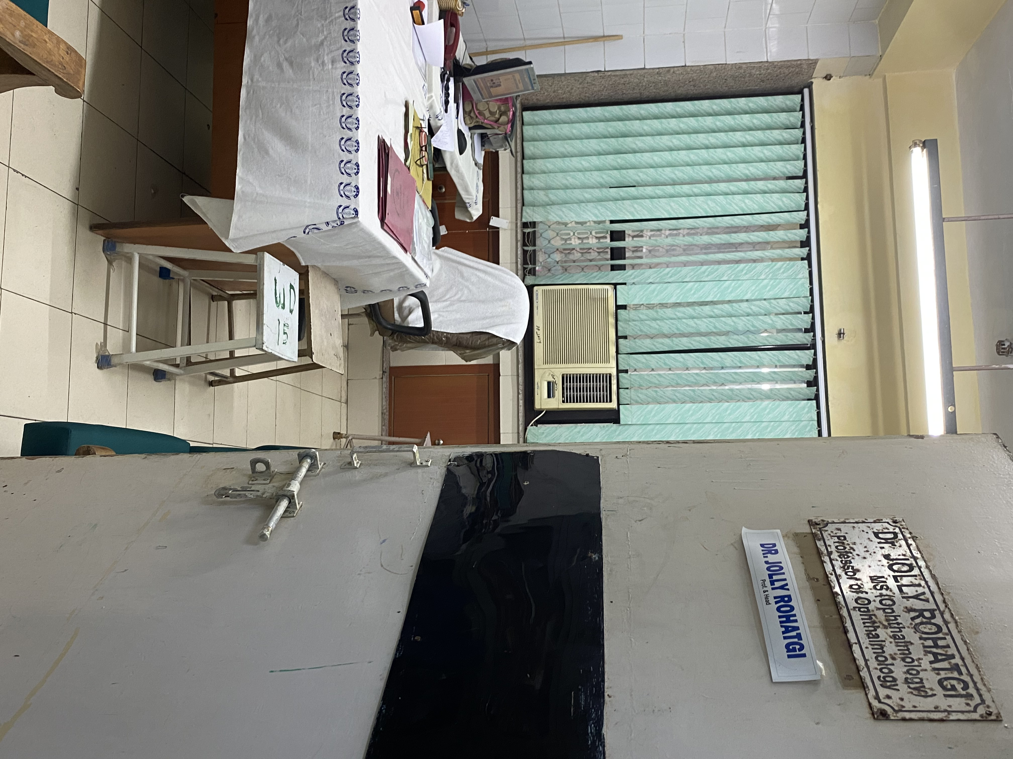
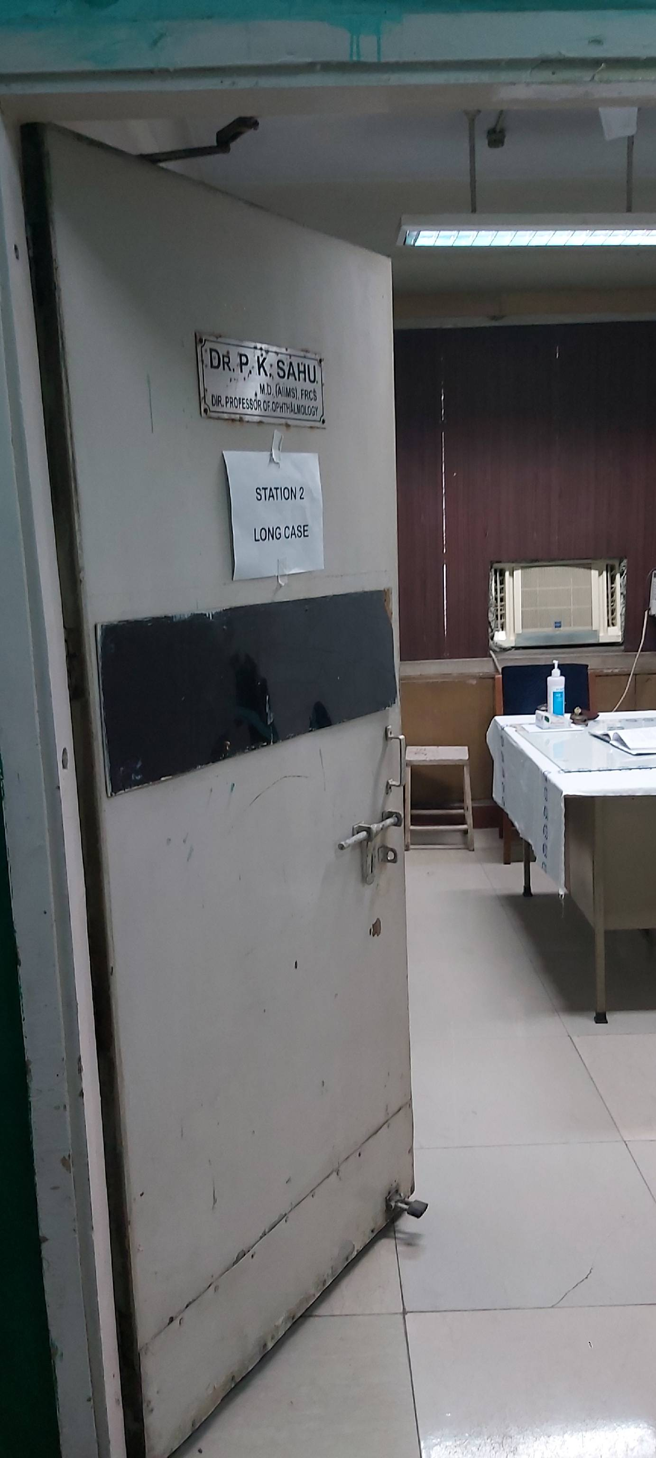
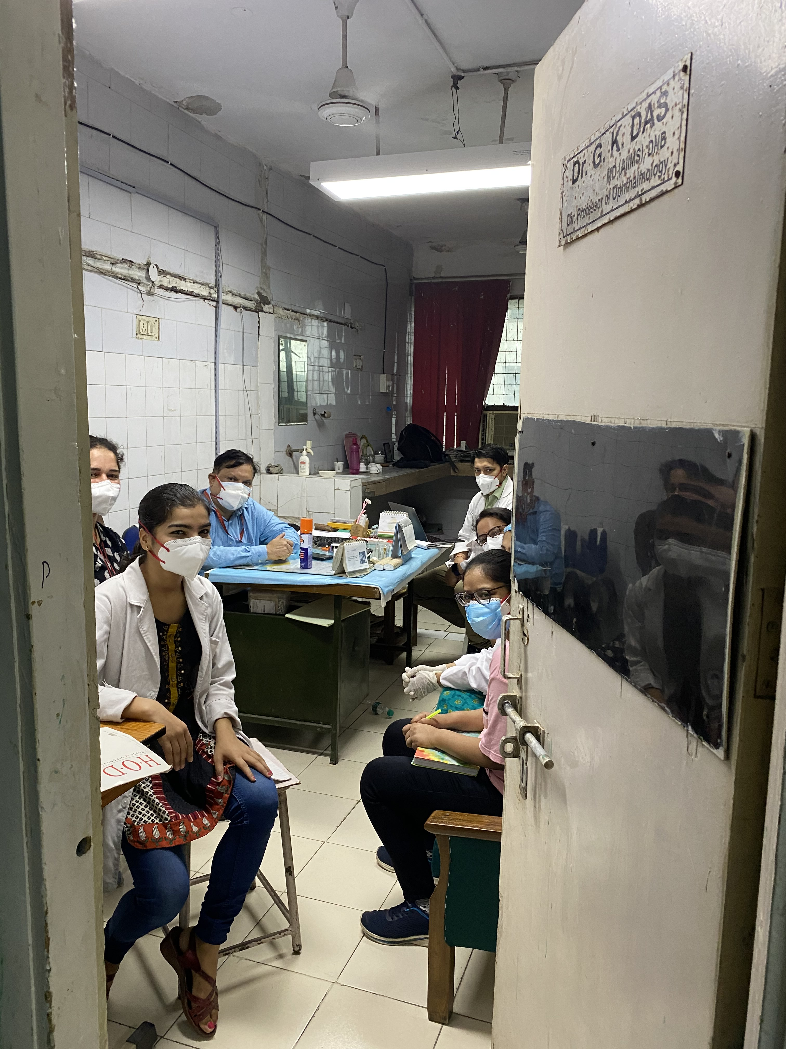
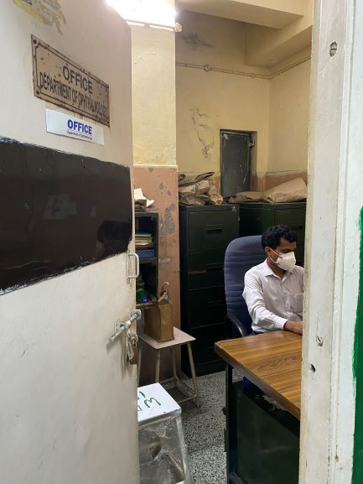
Infrastructure -Offices
 | Infrastructure | Number of Rooms | Criteria Fulfilled
1 | Office space Dept Office HOD room Faculty rooms Computer room | All rooms with intercom and internet connection 1 1 3 1 | Fulfilled

Slide 11
Infrastructure - OPD
 | Infrastructure | Number of Rooms | Criteria Fulfilled
2 | Outpatient department Patient examination rooms Refraction rooms Investigation rooms Clinical Demo room Minor OT Free Spectacle dispensing room | 3 2 2 1 1 1 | Fulfilled

Slide 12
Out-patient department

Slide 13
Infrastructure- In patients
 | Infrastructure | Number of Rooms | Criteria Fulfilled
3 | Inpatient department Total Beds | 40 | Fulfilled

Slide 14
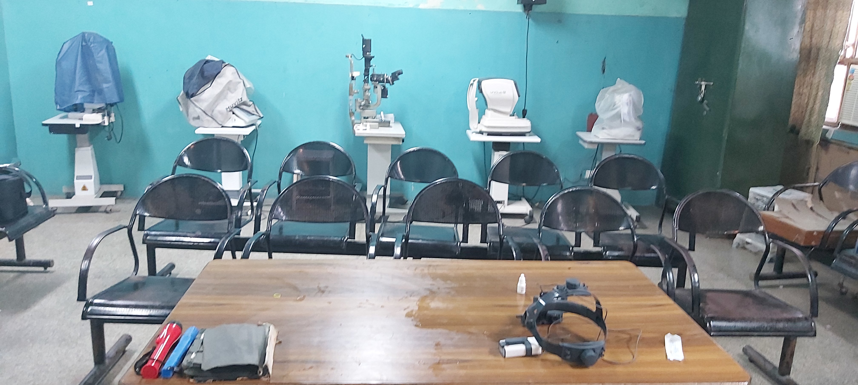
Infrastructure - Teaching space
 | Infrastructure | Number of Rooms | Criteria Fulfilled
4. Teaching rooms | Seminar room( ward) Demonstration room (OPD) Lecture theatres College block | 1 1 4 | Fulfilled

Slide 15
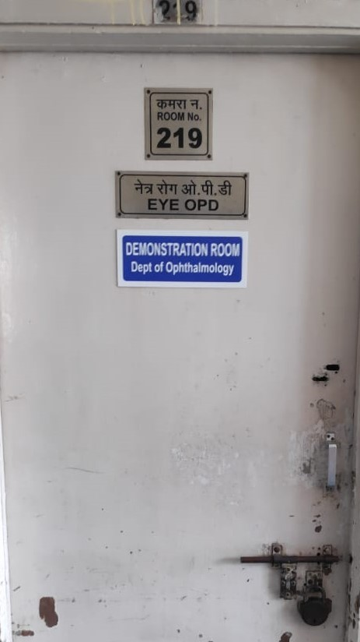
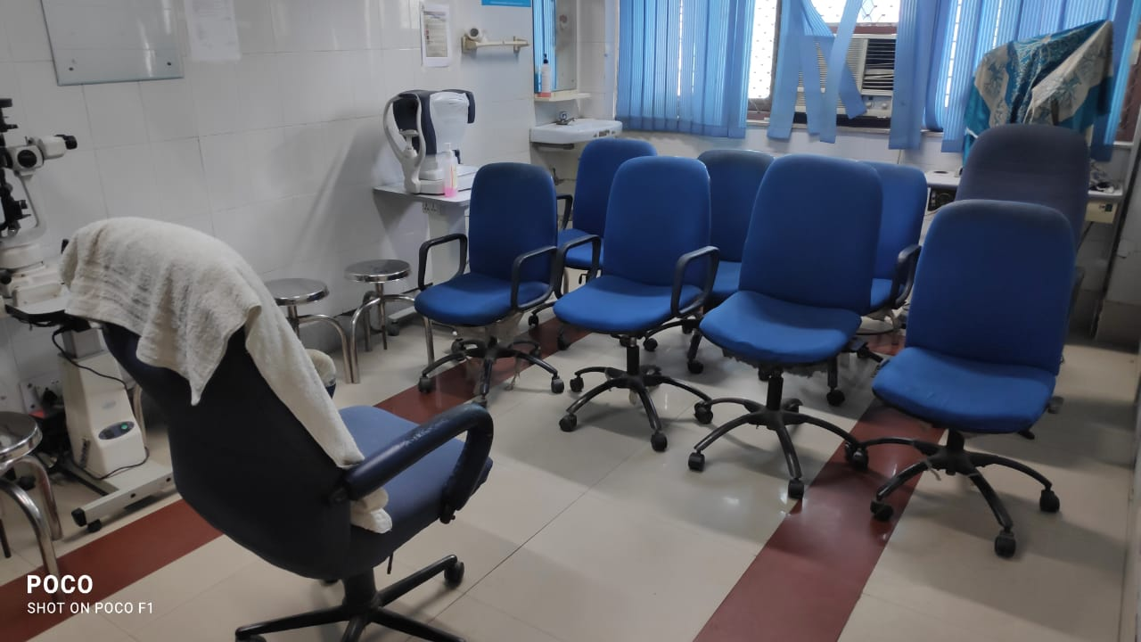
Clinical demo room OPD

Slide 16
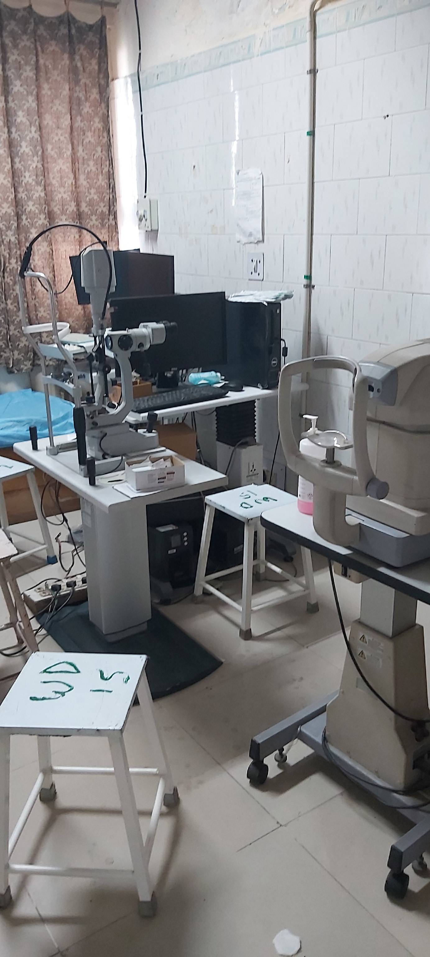
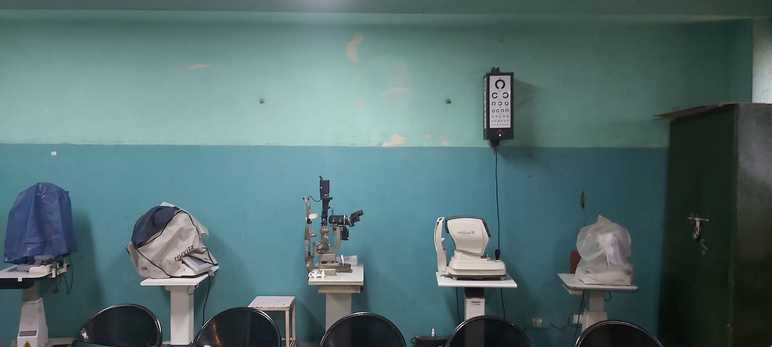
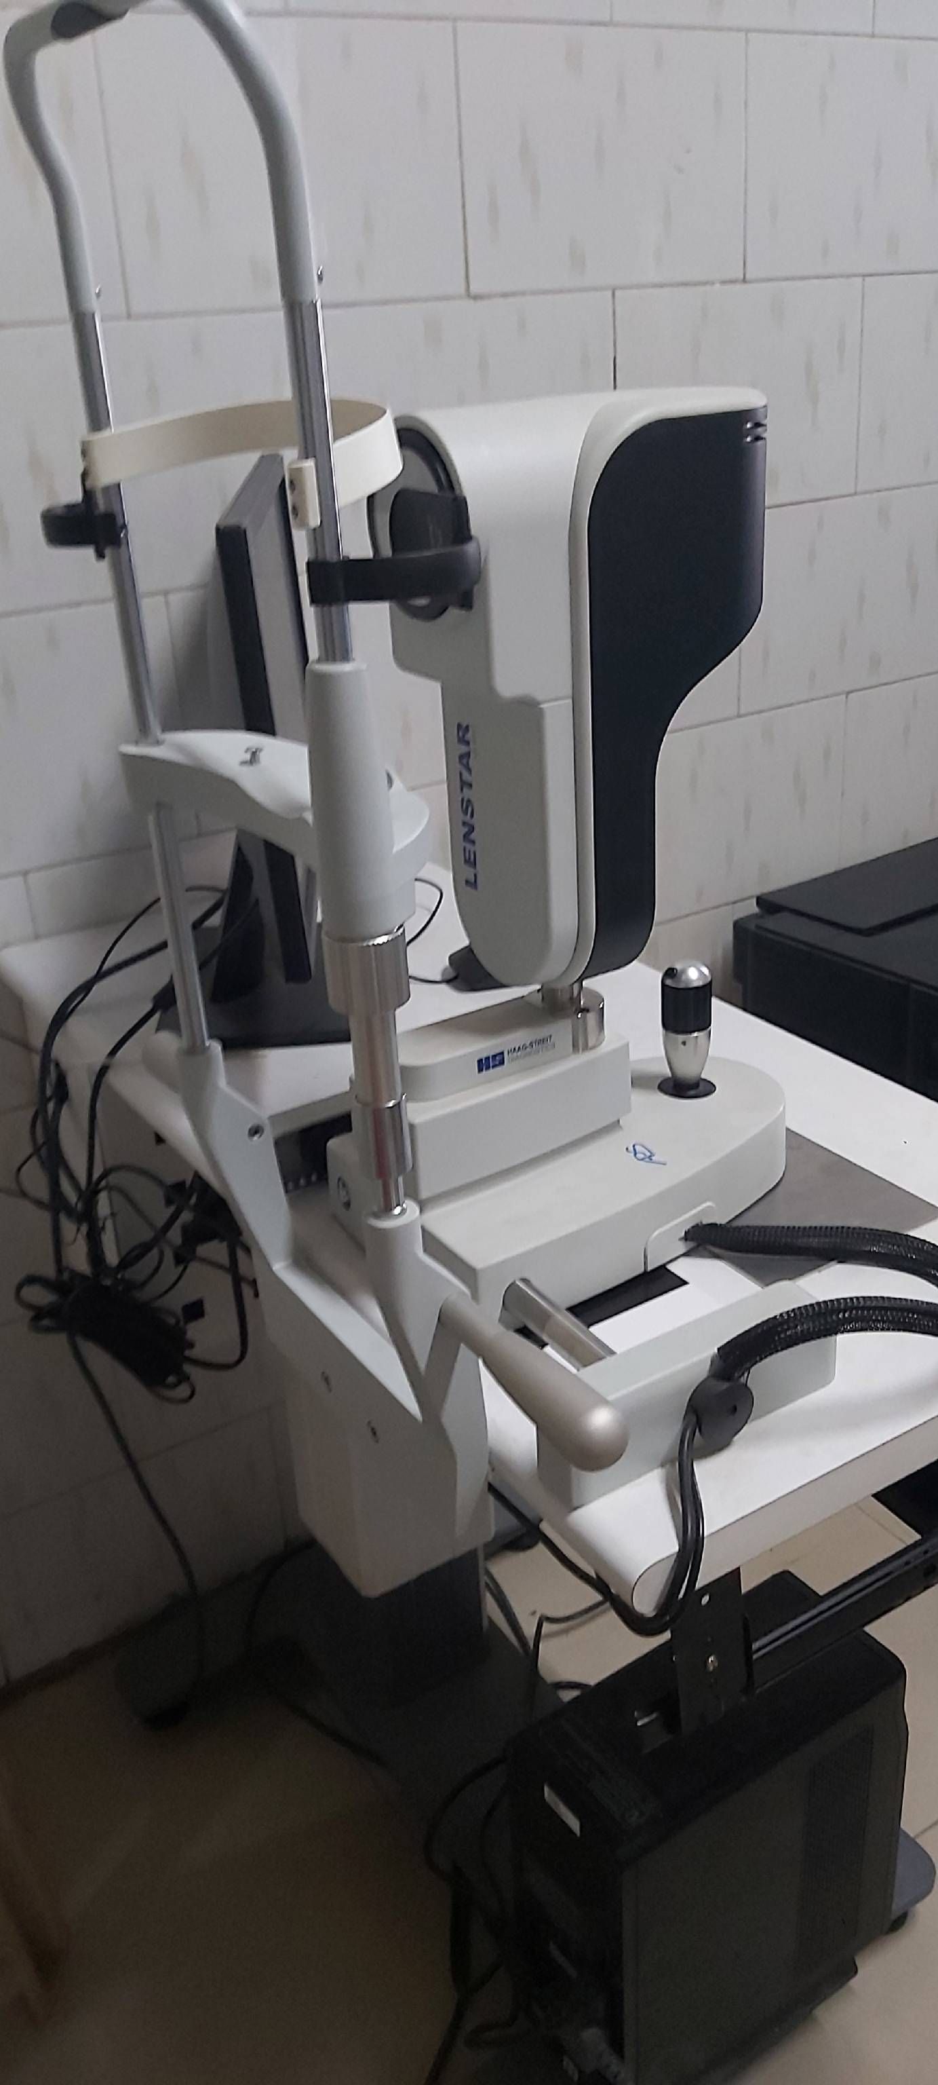
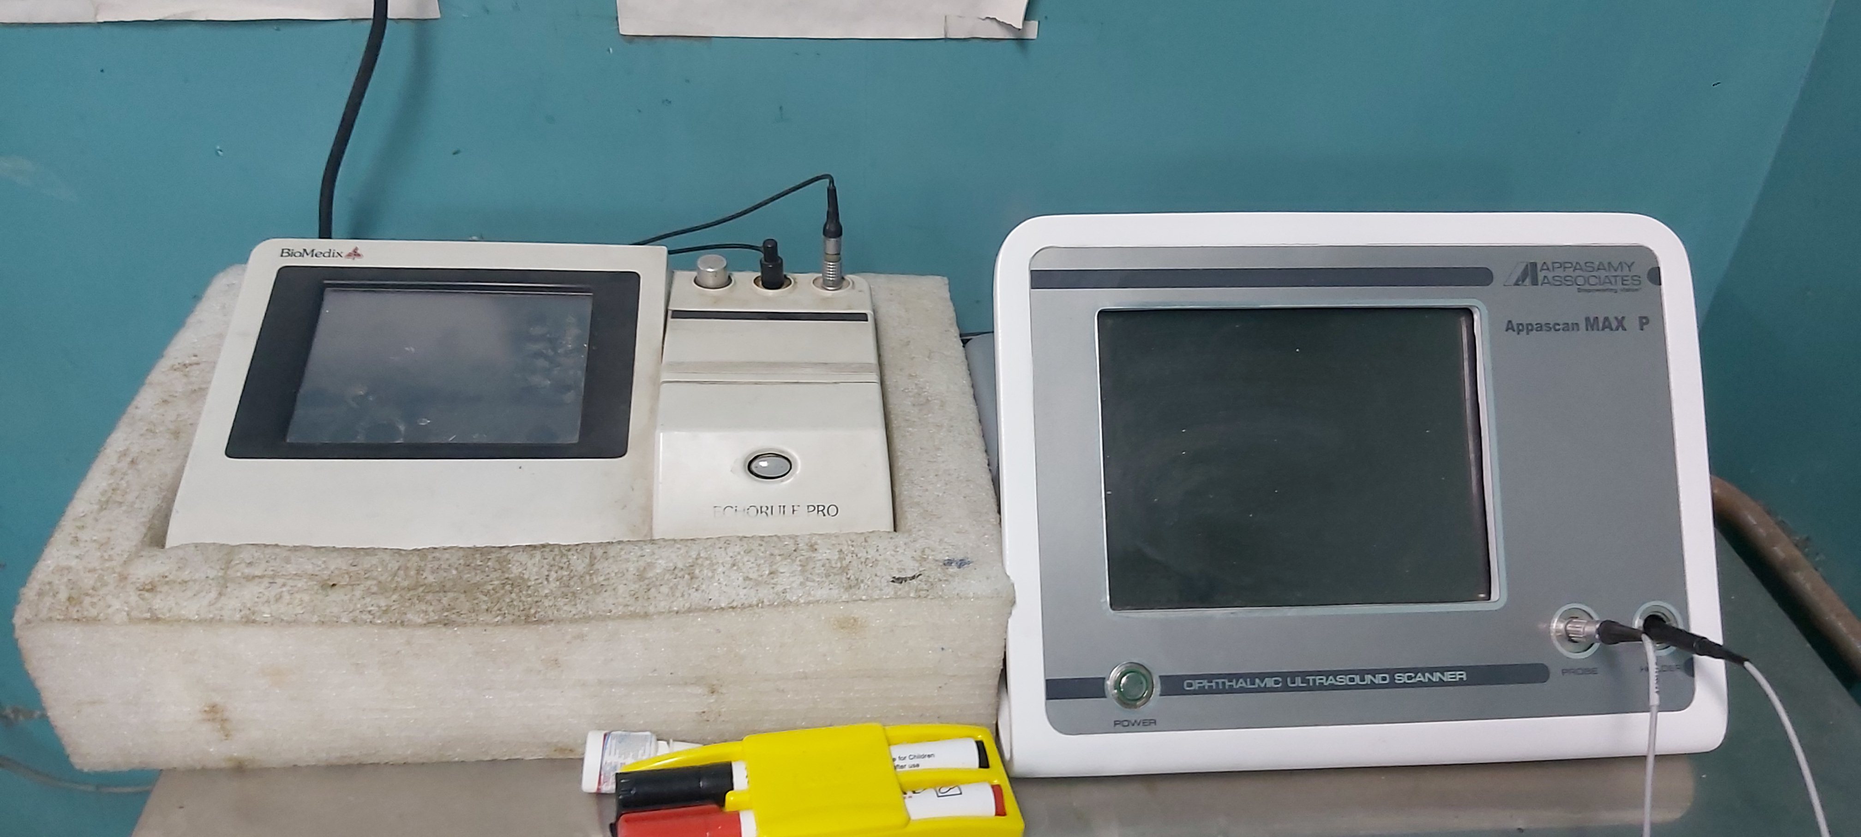
Infrastructure - investigation rooms
 | Infrastructure | Number of Rooms | Criteria Fulfilled
5 | Investigation rooms ( ward) ( OPD) | 3 2 | Fulfilled

Slide 17
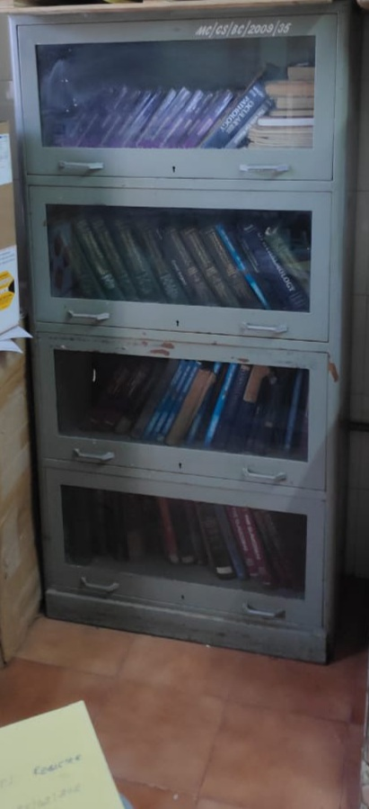
Infrastructure –departmental library
 | Infrastructure | Number of Rooms | Criteria Fulfilled
6 | Departmental library | 1 | Fulfilled

Slide 18
Infrastructure - OTs
 | Infrastructure | Number of Rooms | Criteria Fulfilled
7 | Operation Theatre OT tables Pre operative room Recovery room Changing room for doctors and other staff | 2 4 1 1 6 | Fulfilled

Slide 19
OPERATION THEATRE

Slide 20
RECOVERY ROOM AND OPERATION THEATRE

Slide 21
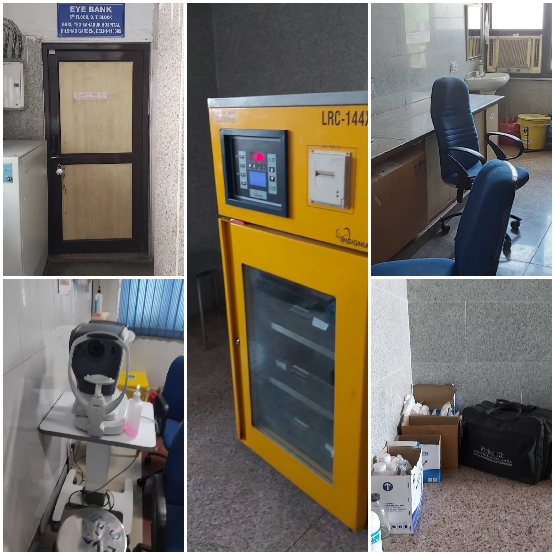
Infrastructure –Eye Bank
 | Infrastructure | Number of Rooms | Criteria Fulfilled
8 | Eye Bank | 1 | Fulfilled

Slide 22
Equipment - OPD
S no | Name of item | Required | Available | Requirment Fulfilled
1 | Snellen Chart/Snellen drum with or without remote control | 4 | 10 | Fulfilled
2 | Trial set with trial frame both for adult and children | 4 | 6 | Fulfilled
3 | Automated Perimeter | 1 | 1 | Fulfilled
4 | Color vision chart - Original Ishihara | 3 | 3 | Fulfilled
5 | Near vision chart with different languages | 4 | 10 | Fulfilled
6 | Ophthalmoscope (Direct) | 4 | 12 | Fulfilled
7 | Streak Retinoscope | 4 | 8 | Fulfilled
8 | Indirect Ophthalmoscope | 3 | 5 | Fulfilled
9 | Slit lamp | 3 | 3 | Fulfilled
10 | Ophthalmoscope (Direct) | 4 | 6 | Fulfilled
11 | Applanation tonometer | 3 | 4 | Fulfilled
12 | Keratometer | 1 | 1 | Fulfilled
13 | Synoptophore | 1 | 1 | Fulfilled
14 | Maddox Rod | 1 | 2 | Fulfilled
15 | Maddox Wing | 1 | 1 | Fulfilled
16 | Diplopia goggles | 1 | 1 | Fulfilled
17 | Gonioscope | 2 | 4 | Fulfilled
18 | Placido disc | 1 | 1 | Fulfilled
19 | Prism Bar | 1 | 2 | Fulfilled
20 | Schiotz’s tonometer/Perkin’s Tonometer | 4 | 4 | Fulfilled

Slide 23
Major equipment in OPD
Fundus Camera - 1
Yag Laser - 1
Automated Perimetry - 1
Retinal laser – 1
NCT – 2
Auto Kerato-refractometer – 2
Focimeter - 2

Slide 24
OPERATION THEATRE
PHACO WITH OPERATING MICROSCOPE
PHACO WITH OPERATING MICROSCOPE

Slide 25
EYE BANK
EYE BANK REFRIGERATOR
SPECULAR

Slide 26
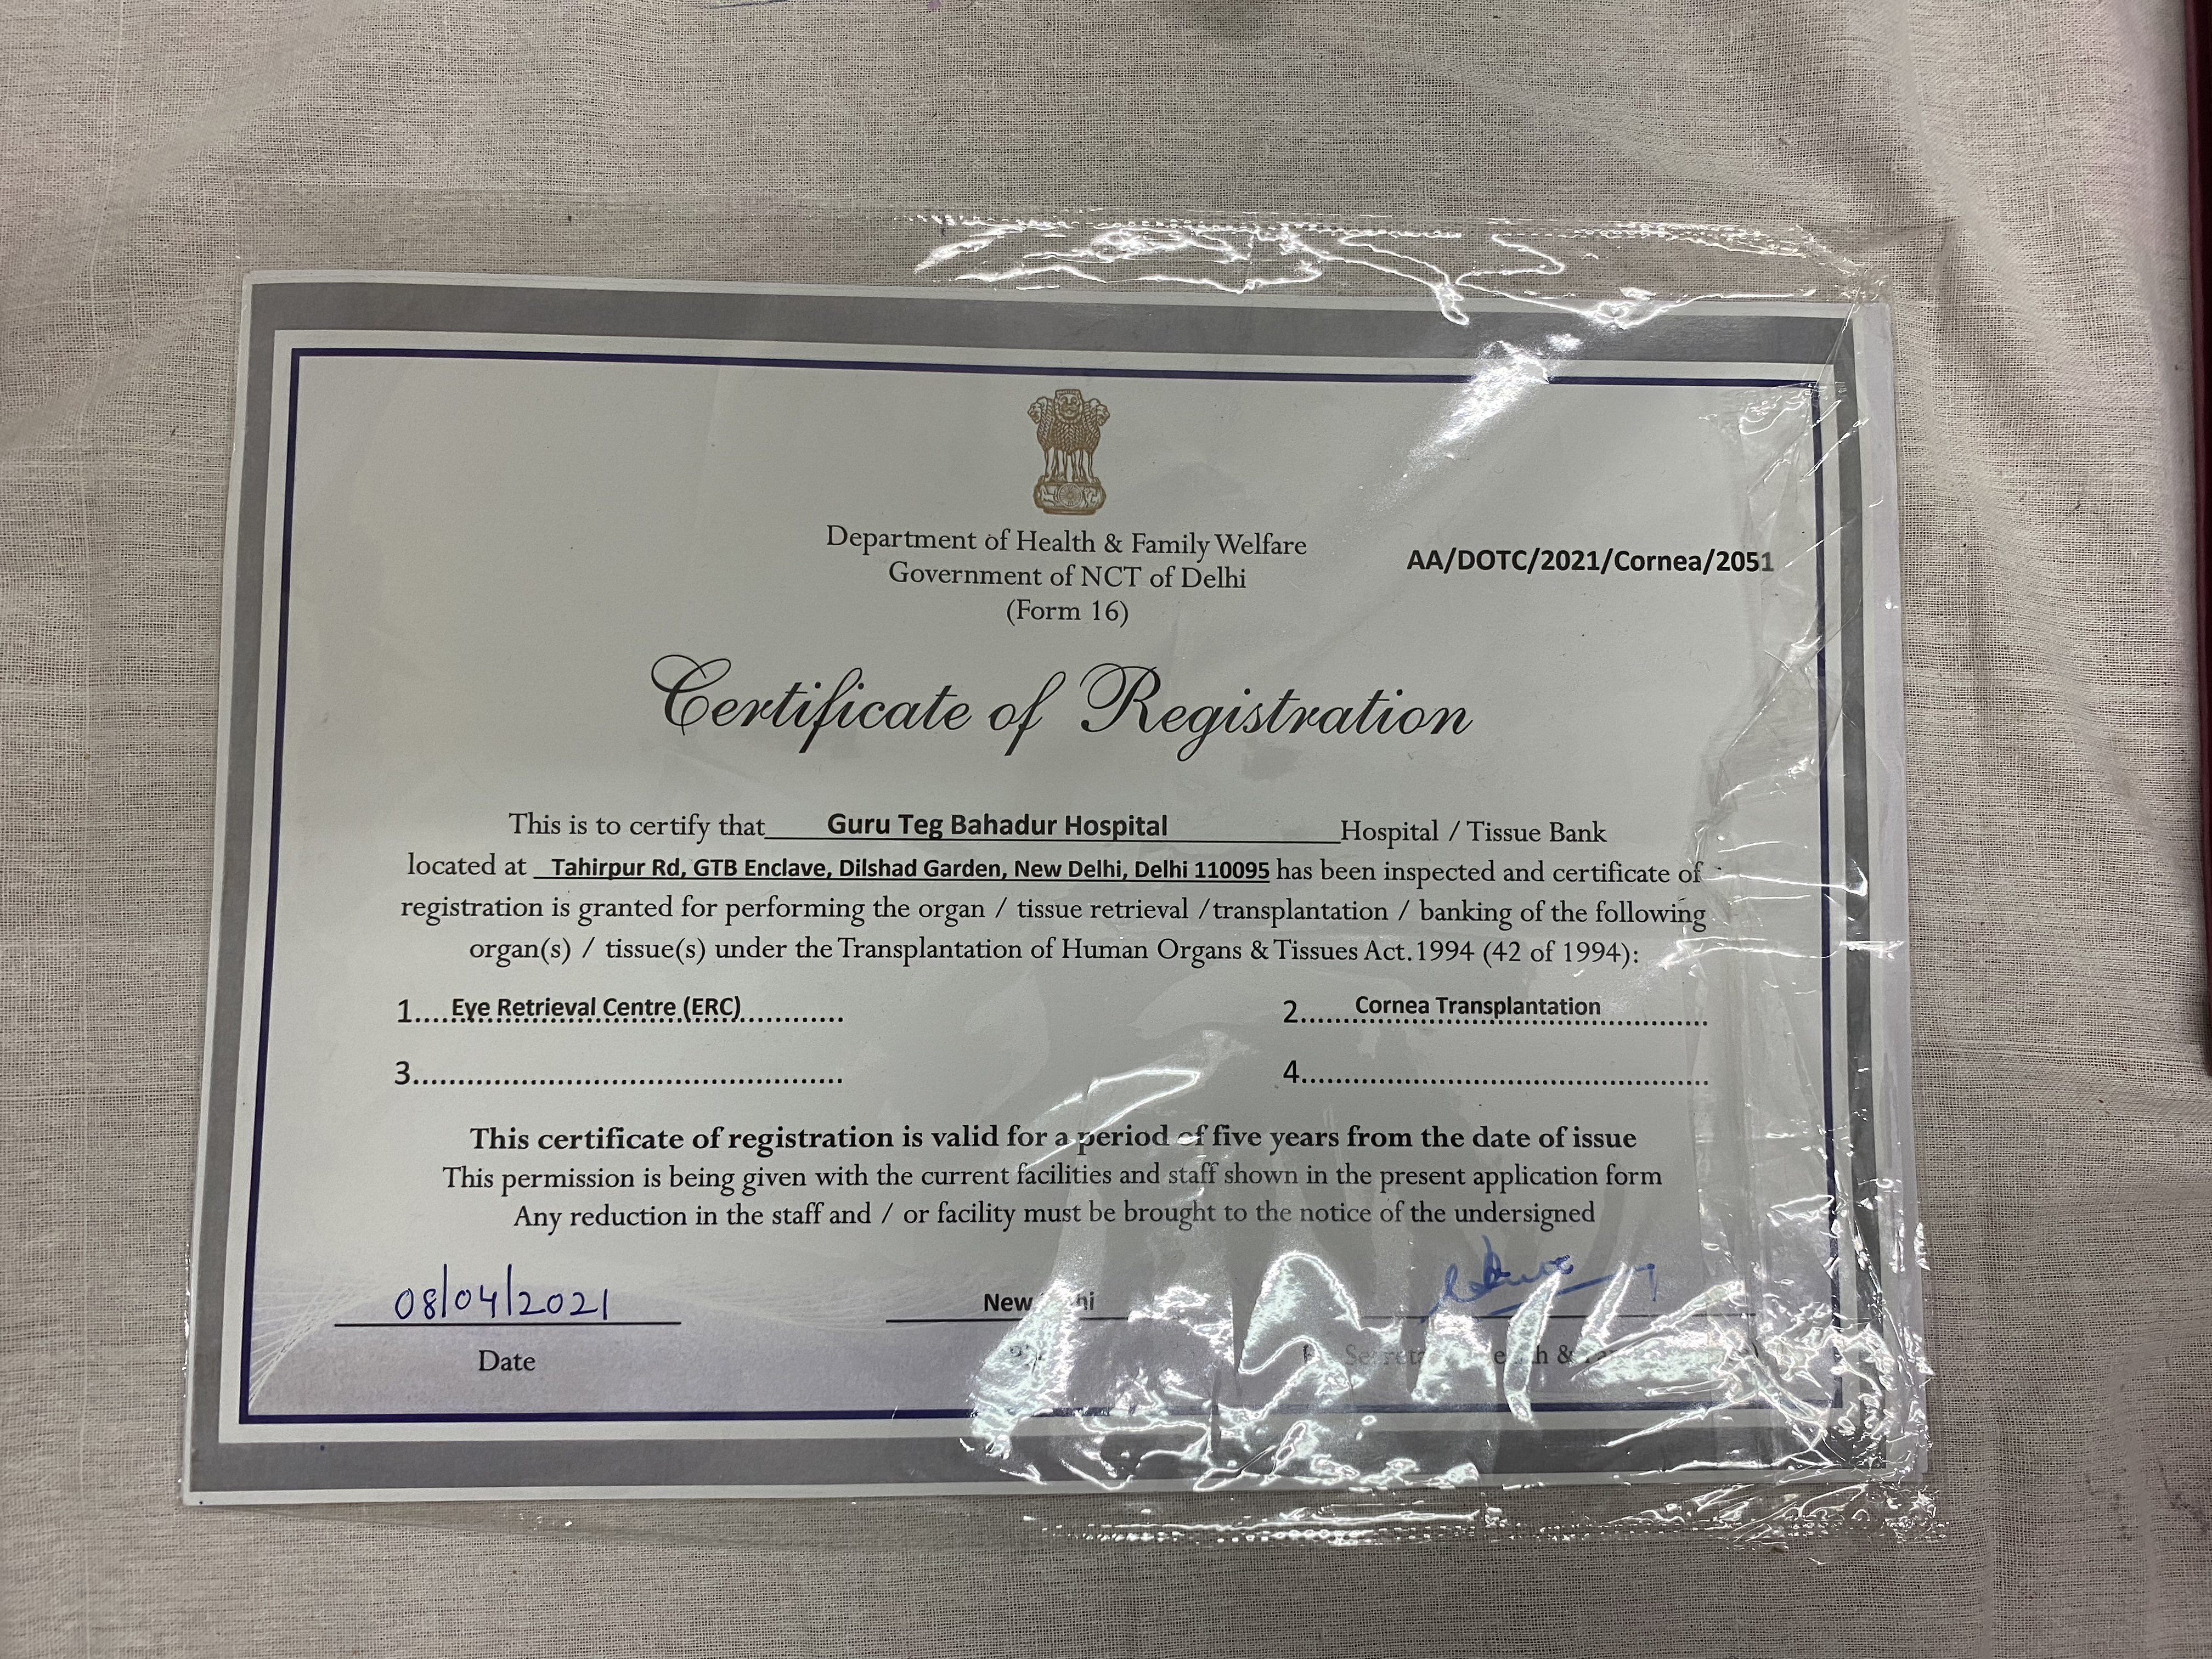

Slide 27
Instruments– Major OT
S no | Name of item | Required | Available | Requirment Fulfilled
1 | Operating microscope with TV Unit with camera | 2 | 4 | Fulfilled
2 | Cryo unit | 1 | 2 | Fulfilled
3 | Cataract set | 6 | 10 | Fulfilled
4 | Glaucoma set | 3 | 3 | Fulfilled
5 | DCR set | 2 | 3 | Fulfilled
6 | Entropion set | 3 | 3 | Fulfilled
7 | Enucleation set | 5 | 5 | Fulfilled
8 | Evisceration set | 2 | 2 | Fulfilled
9 | Squint set | 3 | 4 | Fulfilled
10 | Keratoplasty set |  | 2 | Fulfilled
11 | Vitrectomy set |  | 1 | Fulfilled
12 | Operation Theatre Table | 2 | 4 | Fulfilled
13 | Operation Theatre Light | 2 | 2 | Fulfilled

Slide 28
Major equipment in OT
Phaco machine with anterior vitrectomy - 5
Vitrectomy machine – 1
Endolaser -1
Operating Microscope -4
Cryo sets- 4
Bipolar diathermy – 4
Laser indirect ophthalmoscope-1
Indirect ophthalmoscope -1
Electrolysis machine -1
Equipment for General Anaesthesia

Slide 29
Equipment – Minor OT
S no | Name of item | Required | Available | Requirement Fulfilled
1 | OT table | Should be available | 3 | Fulfilled
2 | OT Light | Should be available | 2 | Fulfilled
 | Instrument for suture removal/foreign body removal | Should be available | 5 sets | Fulfilled

Slide 30
Equipment – Ward
S no | Name of item | Required | Available | Requirement Fulfilled
1 | Slit lamp | 2 | 3 | Fulfilled
2 | Snellen chart/Snellen drum with or without remote control | 1 | 3 | Fulfilled
3 | Trial set with trial frame both for adult and children | 1 | 3 | Fulfilled
4 | Near vision chart with different languages | 1 | 3 | Fulfilled
5 | Torch | As required | 5 | Fulfilled
6 | Ophthalmoscope | 1 | 6 | Fulfilled
7 | Indirect Ophthalmoscope/ video indirect ophthalmoscope | 1 | 4 | Fulfilled
8 | Multi media Projector with Screen | 1 | 1 | Fulfilled

Slide 31
Other equipment available in ward
Autorefrectometer - 4
Keratometer - 2
Autorefkeratometer - 1
Auto lensometer - 3
Visuals Yag-II 2
NCT - 2
OCT – 1
Practice Eye for Retinoscopy – 2
Photo slit lamp – 1
UBM – 2
B scan – 1
VER/ERG/EOG -1
Tonopen – 4
Eye bank specular – 1
Eye bank fridge – 1
Perkin tonometer – 2
Pelli robson CS chart – 2
Eldrige green lantern test – 1
90 D Lens – 4
78 D lens – 1
30 D lens – 1
Hertel’s exophthalmometer -1
Specular microscope -1
Pachymeter – 1
Optical biometer – 1

Slide 32
Clinical material of the Department
S. No. | Average workload | Year 1 2017 | Year 2 2018 | Year 3 2019 | Covid year 2020*
1. | Total no. of patients in OPD | 102293 | 112637 | 117424 | 29029
2.. | Total number of patients admitted(IPD) | 38321 | 22969 | 21605
3. | Total no. of major operations | 2218 | 1805 | 2205 | 600
4. | Total no. of minor operations | 652 | 644 | 670 | 143
5. | Emergencies- MLC Non MLC | 1615 511 | 1460 582

Slide 33
Specialty clinics
S.No. | Name of the Clinic | Days on which held | Timings | Average No. of cases attended (New Cases) | Name of Clinic In-charge
1. | Glaucoma Clinic | Thursday | 1.30pm | 22/ week | Dr. PK Sahu
2. | Retina Clinic | Friday | 1.30pm | 17/week | Dr. Jolly Rohatgi
3. | Refraction Clinic | Daily | 8am-2pm | 150/day | Consultant in opd
4. | Eye Bank | Monday | 1.30pm | 3/week | Dr. PK Sahu
5. | Squint Clinic | Tuesday | 1.30pm | 9/week | Dr. GK Das
6. | Oculoplasty | Saturday | 1.30pm | 11/week | Dr. GK Das
7. | Neurophthalmology | Tuesday | 1.30pm | 5/week | Dr. Jolly Rohatgi

Slide 34
Publications list – 2017 onwards
1. Conjunctival Ulcers in Behcet's Disease and Response to Colchicine
Ishmeet Kaur, Archana Singal, Jolly Rohatgi
Indian Dermatol Online J. 2020 Nov-Dec; 11(6): 1005–1006. Published online 2020 Sep 19. doi: 10.4103/idoj.IDOJ_362_20
PMCID: PMC7734981
2. Outcomes of preoperative intrapterygial injection of mitomycin C for pterygium excision with and without inferior conjunctival flap
Ved Prakash Gupta, Shekhar Sanghi, Jolly Rohatgi, Upreet Dhaliwal
Oman J Ophthalmol. 2019 Sep-Dec; 12(3): 171–176. Published online 2019 Oct 11. doi: 10.4103/ojo.OJO_129_2018
PMCID: PMC6826598

Slide 35
3. Adjustment to acquired vision loss in adults presenting for visual disability certification
Aditya Nakade, Jolly Rohatgi, Manjeet S Bhatia, Upreet Dhaliwal
Indian J Ophthalmol. 2017 Mar; 65(3): 228–232. doi: 10.4103/ijo.IJO_483_16
4. A Prospective Study of Anterior Segment Ocular Parameters in Anisometropia
Neha Singh, Jolly Rohatgi, Vinod Kumar, Korean J Ophthalmol. 2017 Apr; 31(2): 165–171. Published online 2017 Mar 21.doi: 10.3341/kjo.2017.31.2.165
5. Measurement of peripapillary retinal nerve fiber layer thickness and macular thickness in anisometropia using spectral domain optical coherence tomography: a prospective study
Neha Singh, Jolly Rohatgi, Ved Prakash Gupta, Vinod Kumar
Clin Ophthalmol. 2017; 11: 429–434. Published online 2017 Feb 23. doi: 10.2147/OPTH.S123273
6. Comparative Evaluation of Corneal Endothelium in Diabetic Patients Undergoing Phacoemulsification
Pramod Kumar Sahu, Gopal Krushna Das, Sumeet Agrawal, Sabitabh Kumar, Nitish Kumar
Middle East Afr J Ophthalmol. 2017 Oct-Dec; 24(4): 195–201. doi: 10.4103/meajo.MEAJO_212_16
PMCID:

Slide 36
7. Evaluation of intravitreal bevacizumab as monotherapy and in combination with macular grid laser photocoagulation in diffuse diabetic macular edema
Gopal K. Das, Pramod K. Sahu, Laura V. L. Biakthangi, Divya Jain
Oman J Ophthalmol. 2018 Sep-Dec; 11(3): 248–253. doi: 10.4103/ojo.OJO_196_2016
8. Comparative Evaluation of Corneal Endothelium in Patients with Diabetes Undergoing Phacoemulsification
Pramod K. Sahu, Gopal K. Das, Sumeet Agrawal, Sabitabh Kumar
Middle East Afr J Ophthalmol. 2017 Apr-Jun; 24(2): 74– 80. doi: 10.4103/meajo.MEAJO_242_15
9. Cutaneous basal cell carcinoma with mixed histology: Cytomorphological features of two unusual cases
Surbhi Goyal, Ruchi Rathore, Sonal Sharma, Vinod Kumar Arora, Gopal Krushna Das, Archana Singal
J Cytol. 2017 Apr-Jun; 34(2): 115–118. doi: 10.4103/0970-9371.203566

Slide 37
10. Palmoplantar Keratoderma with Keratoconus
Ved Prakash Gupta, Isha Chaudhari
Middle East Afr J Ophthalmol. 2018 Jan-Mar; 25(1): 49–51. doi: 10.4103/meajo.MEAJO_221_17
PMCID: PMC5974819
11. Efficacy of Phacotrabeculectomy Alone versus Phacotrabeculectomy Augmented with Autologous Anterior Capsule Implantation Beneath the Sclera Flap.Das GK, Sahu PK, Kumar S, Biakthangi LVL.
Semin Ophthalmol. 2018;33(2):143-148. doi: 10.1080/08820538.2016.1182558.
12. Oculo-cerebro-renal syndrome of lowe with ectropion uvea
Pramod Kumar Sahu, Gopal Krishna Das, Nitish Kumar BJO, Vol.-44, Issue-2, November, 2018
13. Repair of large full thickness lower lid defect following mass excision using modified hughes procedure
Gopal K. Das, Pramod K. Sahu, Divya Jain, Sabitabh Kumar, Priyanka Dahiya
International Journal of Ocular Oncology and Oculoplasty, April-June, 2017; 3(2):156-159

Slide 38
14. Coping strategy in persons with low vision or blindness – an exploratory study
Puja Rai, Jolly Rohatgi, Upreet Dhaliwal
Indian J Ophthalmol. 2019 May; 67(5): 669–676.
15. Adjustment to acquired vision loss in adults presenting for visual disability certification
Aditya Nakade, Jolly Rohatgi, Manjeet S Bhatia, Upreet Dhaliwal
Indian J Ophthalmol. 2017 Mar; 65(3): 228–232. doi: 10.4103/ijo.IJO_483_16
16. Measurement of peripapillary retinal nerve fiber layer thickness and macular thickness in anisometropia using spectral domain optical coherence tomography: a prospective study
Neha Singh, Jolly Rohatgi, Ved Prakash Gupta, Vinod Kumar
Clin Ophthalmol. 2017; 11: 429–434. Published online 2017 Feb 23. doi: 10.2147/OPTH.S123273
PMCID:PMC5328294

