Slide 1
THYROIDITIS

Slide 2
Thyrotoxicosis
hypermetabolic condition associated with elevated levels of free thyroxine (FT4) and/or triiodo-thyronine (T3).
Hyperthyroidism --excess synthesis and secretion of thyroid hormone by the thyroid

Slide 3
Causes of thyrotoxicosis
Conditions causing hyperthyroidism
Graves’ disease
Toxic multinodular goitre
Toxic adenoma
Trophoblastic tumour
Increased TSH secretion: thyrotrophinoma
Conditions causing thyrotoxicosis not associated with hyperthyroidism*
Thyrotoxicosis factitia
Subacute thyroiditis
Post-partum thyroiditis
Chronic thyroiditis with transient toxicosis
Ectopic thyroid tissue (struma ovarii, functioning metastasis of Ca thyroid)
HIGH RADIO IODINE UPTAKE LOW

Slide 4
RADIO IODINE UPTAKE STUDY
Reported as
Normal
2 hour uptake- < 5%
24 hour uptake <25%

Slide 5
Clinical features
System | Symptom | Sign
CVS | Palpitation, dyspnoea | Tachycardia, atrial fibrillation, cardiac failure, wide pulse pressure
CNS | Restlessness, irritability, insomnia | Tremors, proximal muscle weakness, periodic paralysis
GIT | Increased appetite, hyperdefaecation | Exaggerated bowel sounds,
Eye | Foreign body sensation, prominence of eyes | Stare, lid lag proptosis*, extraocular diplopia*, reduced EOM movements *, exposure keratitis*lagophthalmos
Reproductive system | Short menstrual cycles,loss of libido | Gynaecomastia
Thyroid | Neck swelling | Goitre, bruit
General | Weight loss, weakness, heat intolerance, pruritus | onycholysis, warm and moist skin, hyperpigmentation, palmar erythema

Slide 6
DIAGNOSIS OF THYROTOXICOSIS
Elevated total and/or free T4; elevated T3
Suppressed TSH
For example
total T4 21.8 ug/dl (6-14 ug/dl)
TSH <0.001 uIU/mL( 0.5-5.0 uIU/ml)

Slide 7
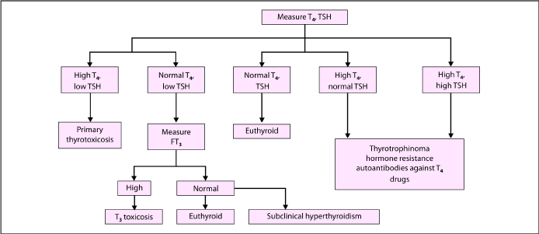
Diagnosis of thyrotoxicosis

Slide 8
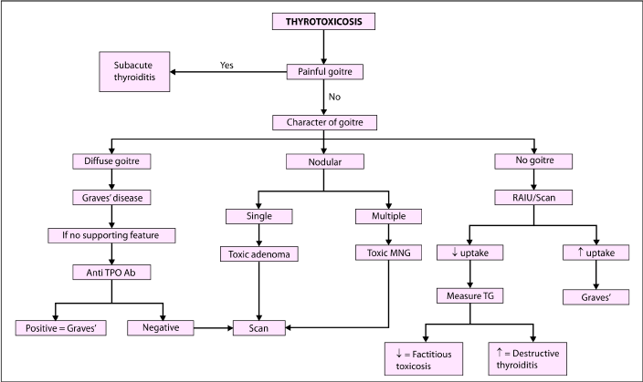

Slide 9
Thyroid Scan
Scintigraphy utilizes one of the radioisotopes of iodine (usually 123-I) or technetium-99m pertechnetate.
These radioisotopes are handled differently by thyroid follicular cells.
Provides information on structure as well as function

Slide 10
Thyroid scan

Slide 11
Thyroid scan

Slide 12
Thyroiditis
Causes of thyroiditis include
Painless
chronic autoimmune (Hashimoto’s) thyroiditis,
postpartum thyroiditis,
Riedel’s thyroiditis,
amiodarone-induced thyroiditis (
Painful
subacute thyroiditis,
acute infectious thyroiditis
radiation thyroiditis
traumatic (e.g. surgery, palpation, FNAB),

Slide 13
Subacute Thyroiditis (de Quervain’s thyroiditis, viral thyroiditis, granulomatous giant cell thyroiditis)
Viral in origin.
Neck pain, which may radiate to ear or mandible. Hoarseness, dysphagia and signs of thyrotoxicosis may be present.
systemic features like lassitude and weakness.
Thyroid gland is very tender and firm.
severe cases may require glucocorticoid therapy.

Slide 14
Postpartum Thyroiditis
Thyrotoxicosis, hypothyroidism, and/or thyrotoxicosis followed by hypo-thyroidism in the first postpartum year
It occurs in 8% to 10% of women in postpartum period
up to 30% of those who were anti-TPO antibody positive in pregnancy.
Women with postpartum thyroiditis have increased risk of developing permanent primary hypothyroidism in the 5- to 10-year
An annual TSH level should be performed in these women.

Slide 15
Riedel’s Thyroiditis
Rare cause of thyroiditis
Fibrosis of the thyroid
Stony hard, immobile goitre resulting in pressure symptoms due
Manifestation of IgG4 related disease :

